Slide 1
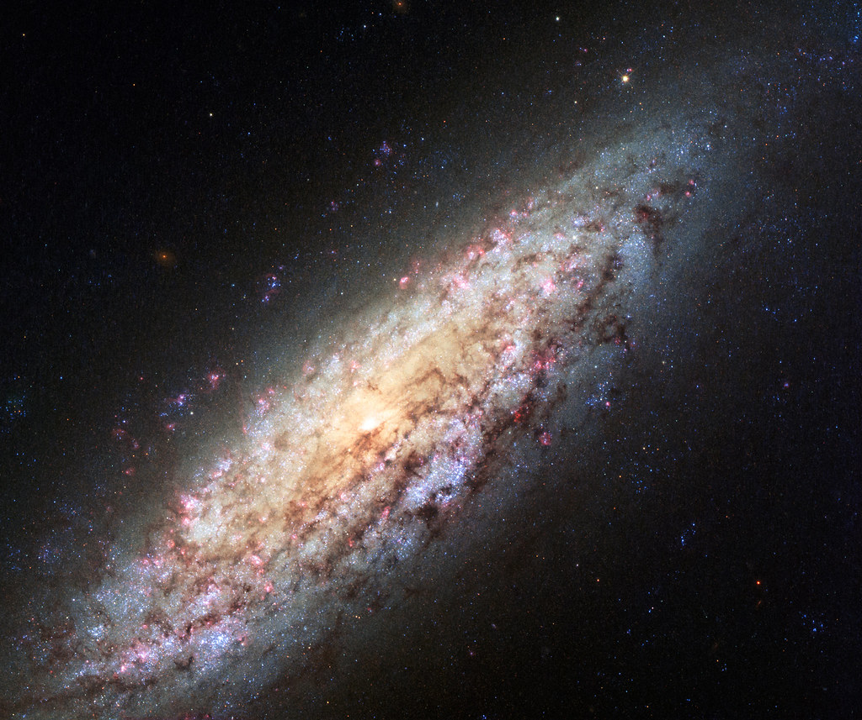
Replicate Antikythera
Group: Krisila, Nuno, Ethan, Anthony, Marc, Kloe, Josh (NightHawk), Md
This Photo by Unknown author is licensed under CC BY.

Slide 2

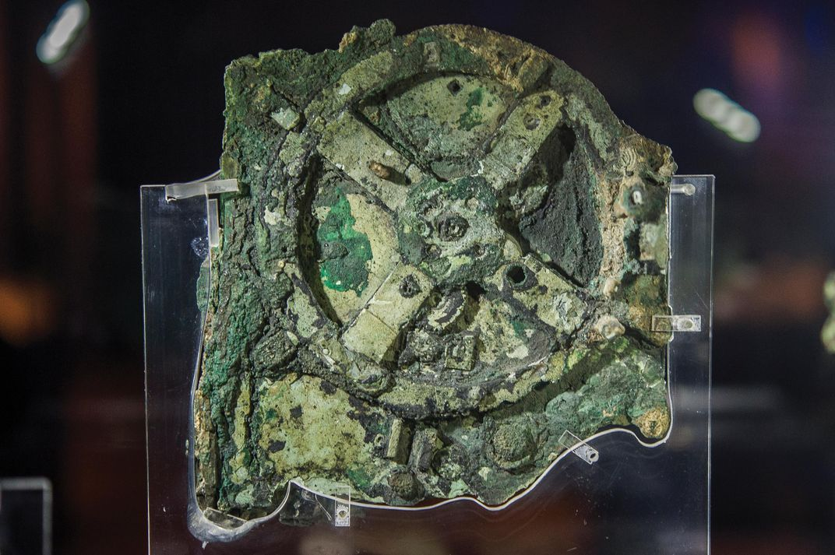
Project Description
Discovered in 1901 from a sunken trading ship in the Mediterranean Sea
Considered the first computer
Greek device over 2000 years old
An astronomical system used to model the passage of 5 calendar systems and predict certain astrological events such as lunar and solar eclipses
Consisted initially of interlocking gears
Greek design centered Earth as the center of the universe (geocentric)

Slide 3
Requirements
Simulate the functionality of the original Antikythera Mechanism
The Sun pointer was used as the base gear, all other gear ratios are based on 1 year of rotation
Simulate the rotation of the nine planets
Based on the rotation of the sun, predict solar and lunar eclipses, what constellations are visible at that time, and what meteor showers will occur

Slide 4
Prediction Component
Two functions: search the database for celestial events by date and run predictions from the Antikythera Mechanism
Prediction function coded first; testing was incremental
Gear ratios were tested to ensure they output proper values, then eclipses were tested to ensure they appeared only when necessary
Search function; testing was incremental
First the search function was designed to accept user input
Next, the search function was set to take the date of the computer running the program

Slide 5
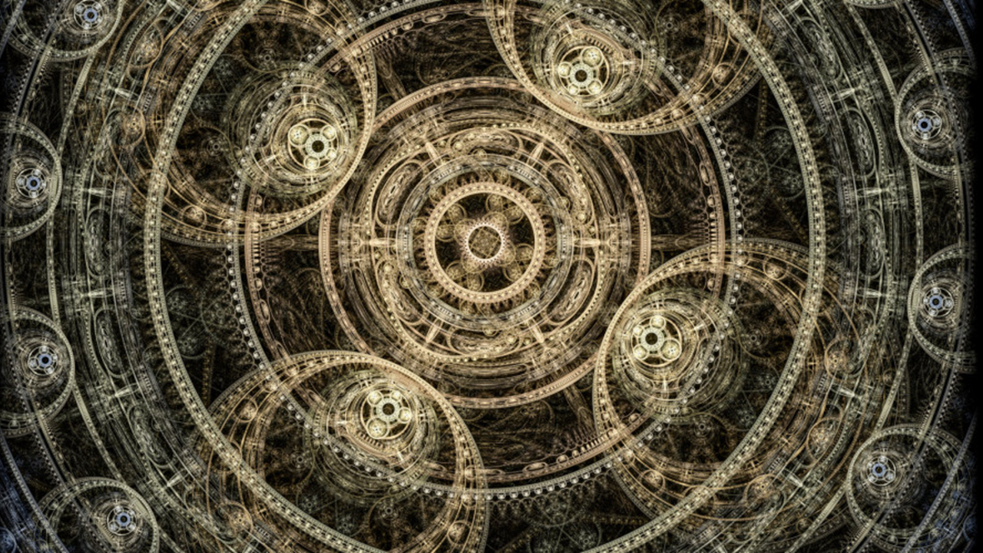
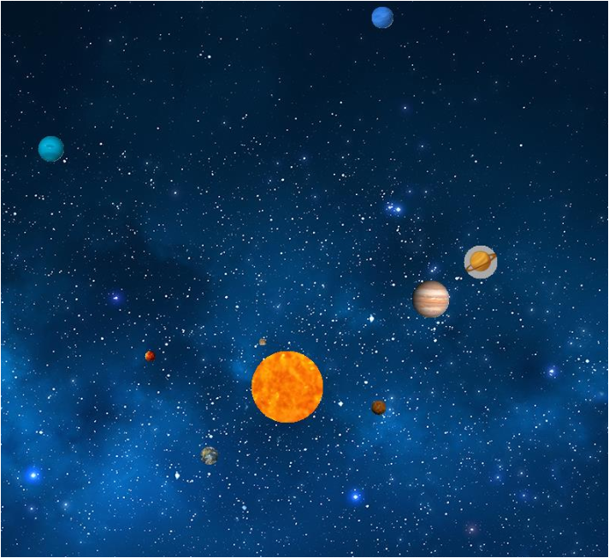
GUI
Made into an executable to be opened from main system.
Orbit
All planets orbit sun with relative speeds in comparison to each other.
Spacing between planets – scaled down but relative to actual distances
Predict
Month/year (separately)
Monthly predictions include message boxes containing events happening (for inputted month)
Hovering over planets displays relative information

Slide 6
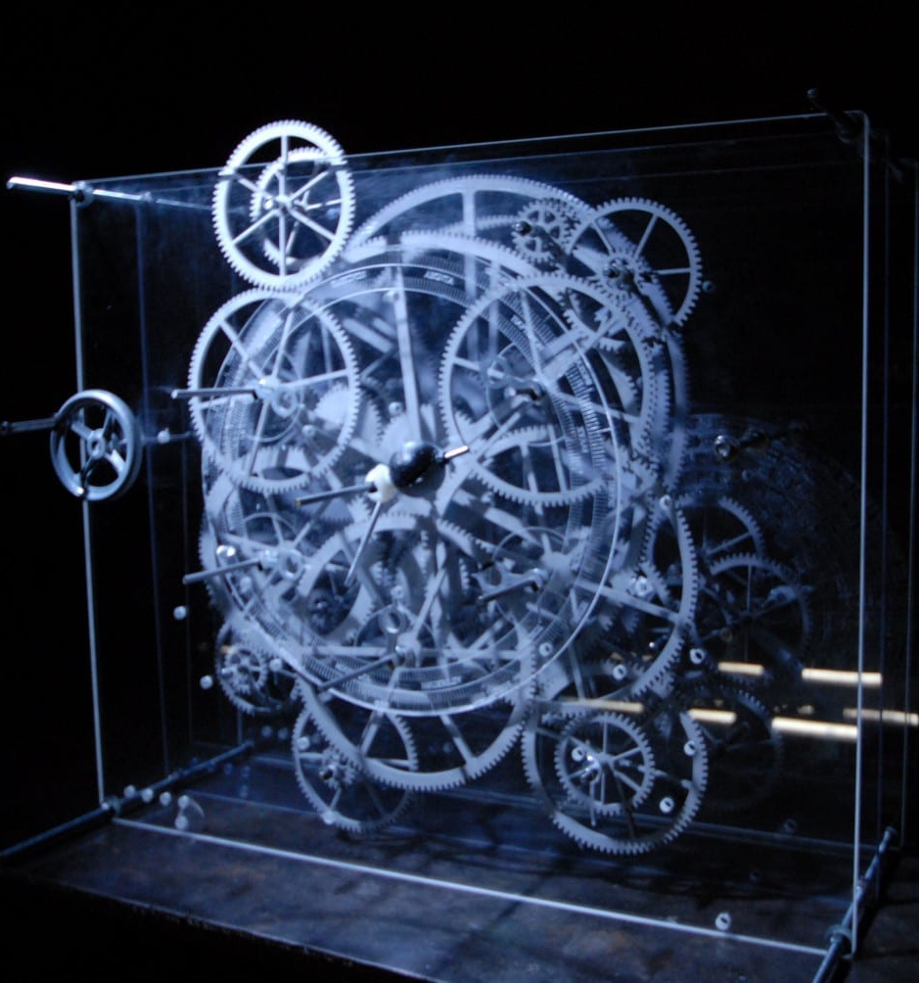
Replicate Antikythera An executable
Final version is released as an exe file
The purpose was to tie the GUI and Prediction component together, allowing ease of use for the user
User can independently track the orbit while search for various space events simultaneously
Space events include:
Meteor Showers
Movement of various constellations
Lunar and Solar eclipse(s)

Slide 7
System Design
To run the executable. Download the final project zip folder and extract the files
Set up your environmental variables following closely the User Guide Instructions
Setting up these variables is required to get the program to run on your machine. All libraries in bin folder are necessary
Double click the Antikythera Mechanism.exe and the program will open a menu
The menu will either open the GUI or ask you prediction questions based on your response
The program will continue to run after you respond until you choose to end.
Then the program will close.

Slide 8
Comments from Testing
Added history section for new user's knowledge
Infinite loop fixed to reduce/limit repetition.
- Fixed date issue that goes beyond 12 months/30 days.
Added ability to run month and year at the same time
Initial menu appearance and track planet orbit fixed

Slide 9
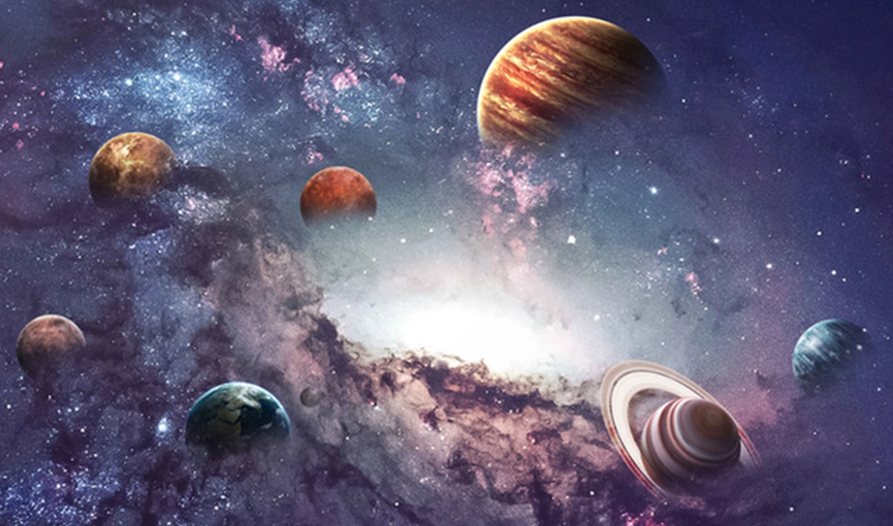
Thank you!

